Slide 1
A Whole New Approach to Life Insurance
Ben Koplan, CLU, CFP®
Advisor’s Choice Insurance Brokerage Services
MLINY072315132
Vitality is the provider of the John Hancock Vitality Program in connection with policies issued by John Hancock. Insurance products are issued by John Hancock Life Insurance Company (U.S.A.), Boston, MA 02117 (not licensed in New York) and John Hancock Life Insurance Company of New York, Valhalla, NY 10595.

Slide 2
Agenda
A Smarter Approach to Life Insurance
John Hancock’s Partnership with Vitality
John Hancock Life Insurance Products with Vitality
Overview of the Vitality Program
The Customer Experience

Slide 3




Current Customer Experience
Bob, age 43
Underwriting
Buy Life Insurance Policy
Premium Notice

Slide 4
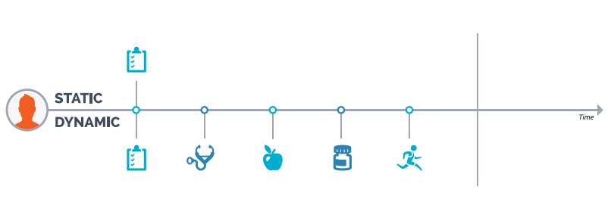
Current “Static” Underwriting Model

Slide 5
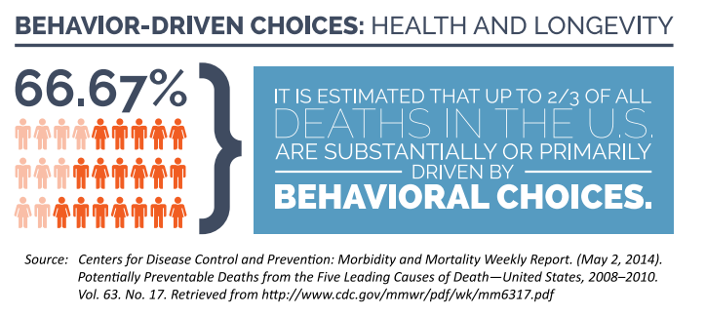
Behavior-Driven Choices & Prevention

Slide 6
A Smarter Approach to Life Insurance
Life insurance should reward your clients for living. That’s why John Hancock is taking a whole new approach — one that can protect your client’s family while supporting their pursuit of a healthier and longer life.
Life insurance that protects clients and their families
no matter what life brings
The opportunity to significantly lower premiums
Personalized health goals, wellness information, and
a free Fitbit® to track progress
Entertainment, shopping, and travel rewards as well
as discounts

Slide 7

A New Exclusive Partnership in the U.S.

Slide 8


It’s Happening Now
South Africa

Slide 9

It’s Happening Now
United Kingdom
South Africa

Slide 10

It’s Happening Now
United Kingdom
China
Singapore
Australia
South Africa

Slide 11


It’s Happening Now
United Kingdom
Germany
China
France
Austria
Singapore
Australia
South Africa

Slide 12
It’s Happening Now
United Kingdom
Germany
China
France
Austria
Singapore
Australia
South Africa

Slide 13
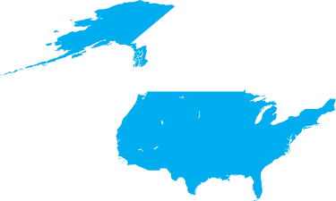


John Hancock and Vitality
A New Exclusive Partnership in the United States
United Kingdom
China
United States
Germany
France
Austria
Singapore
Australia
South Africa

Slide 14
Changing the Conversation About Life
John Hancock’s new approach to Life Insurance is now about living healthy. The John Hancock Vitality Program allows you to:
Deliver more value and strengthen client relationships
Open doors for new clients and referrals
Engage clients throughout their lives
Talk to your clients about living for today while still planning for the future

Slide 15
First Tool of Engagement
Determine Vitality Age™
Clients will complete a Vitality Health Review (VHR)
to determine insured’s “Vitality Age”
Essentially, based on health and lifestyle
how old is the body you are living in?
Engagement is driven by seeing our
bodies older than our actual age
Engagement is driven by reinforcing
healthy behaviors and lifestyles
Americans on average are
5 years older than they think¹
Americans are
on average
5 YEARS OLDER
than they think¹
1. Source: The Vitality Institute

Slide 16
Vitality Age
High-Impact, Easy-to-Understand Barometer of Health Status
BOB
SEX: Male
AGE: 43
RISK FACTORS: Overweight, smoker, elevated cholesterol
MEMBER
INPUT
REAL-TIME
ALGORITHM
VITALITY AGE:
46 YEARS
+
=
A medically
and actuarially derived tool
15 years of development
75 million life years of data
Medical history
Stress & productivity
Smoking & alcohol
Nutrition
Physical activity
Screening data
Medical data
Actuarial data
Risk factors applied to calculate age
Vitality Goals presented

Slide 17
Second Tool of Engagement
Vitality Status
Engagement
drives healthy behavior leading
to higher status levels, savings
and rewards!

Slide 18


Third Tool of Engagement
Rewards
POTENTIAL PREMIUM SAVINGS
FREE FITBIT® DEVICE
WEARABLE DEVICE
DISCOUNTS
HALF-PRICE HOTEL NIGHTS
CRUISE REWARDS
SHOPPING & ENTERTAINMENT
HEALTHY GEAR
DISCOUNTS
FREE HEALTH CHECK
New rewards and discounts will continuously be added!

Slide 19


Free Fitbit
Clients get a free Fitbit once they complete
their Vitality Health Review (VHR)
Register their Fitbit online to automatically
track activities
Clients can use their own devices

Slide 20
Wearable Devices & Healthy Gear
25%-40% discount on wearable devices
  Fitbit
  Polar
  Garmin
25% discount on e-gift cards at REI
  Earn a 25% discount on electronic gift cards from Vitality to purchase outdoor gear. From backpacking to cycling to staying in shape, REI has the equipment you need to take your training to the next level.

Slide 21


Health Check
Free health screening from affiliated partners
  Results are automatically recorded earning the member even more Vitality Points
  Walgreens
  Quest Diagnostics

Slide 22






Lifestyle Rewards
Half-price hotel nights at any Hyatt hotel worldwide
  The higher the Vitality Status, the more nights can be purchased in a given year
20% to 50% on all Royal Caribbean International, Celebrity Cruises, Crystal Cruises, Yachts of Seabourn, and Azamara Club Cruises.
  The higher the Vitality Status, the larger the discount

Slide 23




Anytime Rewards
Rewards for healthy successes with:
  gift cards
  movie tickets
  other prizes
The more your clients accomplish, the more
opportunities they’ll have to earn rewards from these and other leading retailers
REI is not affiliated with the John Hancock Vitality Program. REI does not sponsor, endorse or have any responsibility for this promotion.
iTunes is a registered trademark of Apple Inc. All rights reserved. Apple is not a participant in or sponsor of this promotion.

Slide 24
How the Vitality Program Works
Accumulate Vitality Points: Earn Vitality Points by completing simple health-related activities
Earn a Vitality Status: Each year, your client’s status level will be determined based on the number of points they accumulate
Enjoy Savings and Rewards: The higher your client’s Vitality Status the more your client’s can earn in potential premium savings and rewards

Slide 25

Accumulate Vitality Points
Each year, members can earn Vitality Points for everyday things like:
  Walking, exercising, going to the doctor or even getting a flu shot
Based on the number of points they accumulate, your clients will earn a Vitality Status – Bronze, Silver, Gold, Platinum

Slide 26
Earning Vitality Points is Easy
Earn points through
  Annual health check-up at doctor, Walgreens or
  Quest Diagnostics
  Exercise – gyms, events (such as 5K), personal exercise
  Education – online wellness courses through www.JohnHancockVitality.com
Many different methods of earning exercise points
  Using Fitbit or other fitness devices
  MapMyFitness mobile app
  Gym check-in using the John Hancock Vitality mobile app
  Visiting a partner gym and swiping a membership card
  Logging activities

Slide 27
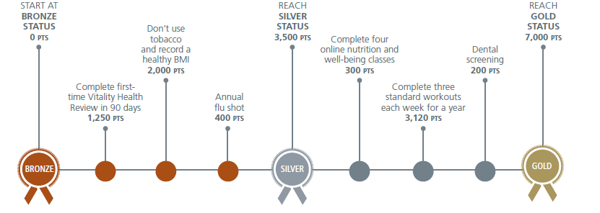
Earn a Vitality Status
On their policy anniversary, they’ll earn premium savings that reflect the status level they’ve achieved
Below is an example of some simple activities clients can do to achieve a Gold status

Slide 28
The Gold Standard
On-Line Reviews
Annual Vitality Health Review (VHR)
BONUS – Complete VHR in first 90 days
BONUS – First time VHR
Physical Activity Review
Vitality Check/Biometric Readings
Non-Tobacco user
4 Readings Passed Automatically From Underwriting
500 points
250 points
500 points
250 points
1,500 points
1,000 points
4 readings x 125 points = 500 points
1,500 points
That’s 3,000 Vitality Points!

Slide 29
The Gold Standard
Screenings
Cholesterol
Blood Sugar
Blood Pressure
Body Mass Index
1,000 points
1,000 points
1,000 points
1,000 points
4,000 points
7,000 Vitality Points!
You’ve achieved Gold Status!

Slide 30
Who is a Good Fit for This Product?
Anyone who wants to save money on their life insurance premiums can benefit from the John Hancock Vitality Program:
  People who are already living healthy lifestyles — they exercise, receive annual health screenings and stay tobacco-free.
  People who recognize the importance of healthy living – they are committed to making changes to their current lifestyle. Perhaps a life event or health diagnosis has persuaded them to take steps that will improve their health.

Slide 31
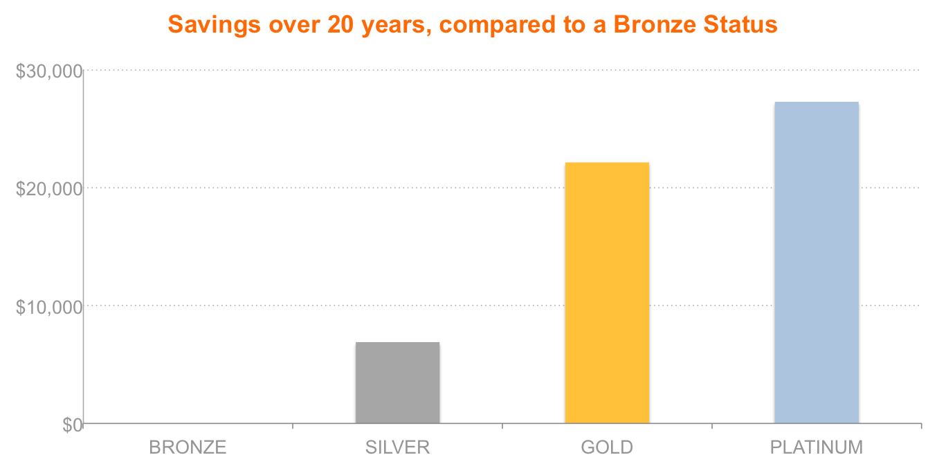
Live a Healthy Life - and Save
Protection UL with Vitality Savings by Status Level
$27,280
13% Savings
$22,140
10% Savings
$6,900
3% Savings
$0
Male, 55, Preferred Non Smoker Risk Class, $1,000,000, Level-Pay. The projected savings above represent the difference between attaining the higher status shown and remaining at Bronze status. Protection UL with Vitality’s premiums are based on current assumptions solve to
$1 at age 121 at each of the four Status levels and include a guarantee to age 82 assuming Bronze funding level, 81 assuming Silver funding level, 80 assuming Gold funding level, and 79 assuming Platinum funding level.

Slide 32
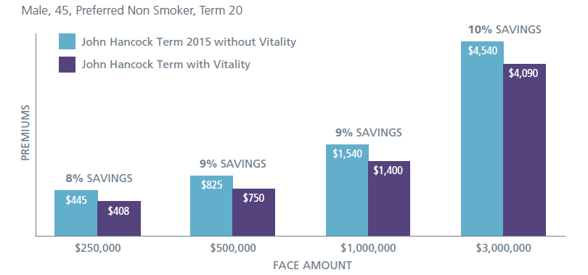
John Hancock Term with Vitality
John Hancock Term with Vitality provides:
  Competitive pricing plus to opportunity to lower premiums even further
This example shows the difference in initial premium for varying face amounts of John Hancock Term with Vitality and John Hancock Term 2015 without Vitality. After the first year, premiums for John Hancock Term with Vitality are not guaranteed because they will adjust annually based on a Life Insured’s participation in the program and the Vitality Status they achieve.

Slide 33
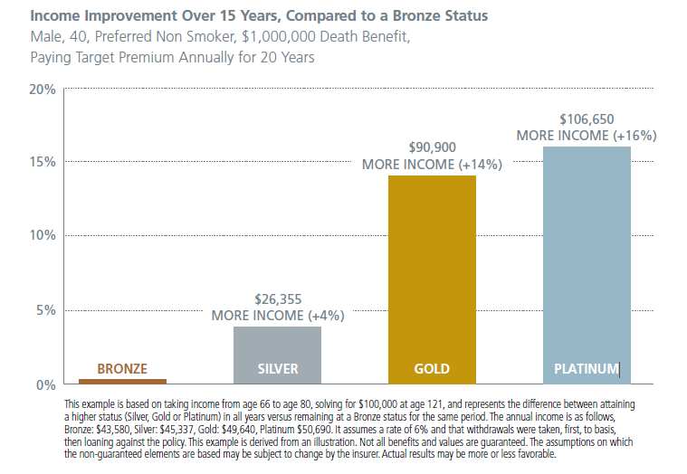
Live a Healthy Life – and enjoy more!
Accumulation IUL with Vitality Income by Status Level

Slide 34
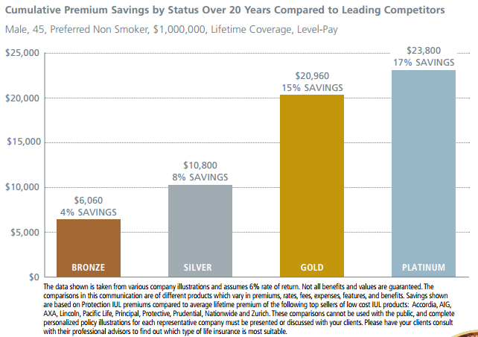
Live a Healthy Life – and enjoy more!
Protection IUL with Vitality Savings by Status Level

Slide 35














The John Hancock Life Insurance with Vitality Customer Experience
Bob, age 43, buys life insurance policy
Initial Vitality
Status: Bronze
Vitality Age: 46
Goal: Lose 10 lbs.
Earn points for biometrics from underwriting
Free Fitbit
Earn points for completing 5K
Receive email notifications of points earned
Earn points for going to the gym
Silver Status Achieved
Earn points for online health courses
Gold Status Achieved
Save 50% on luxury hotel stay
Vitality Age:
43
Lost 10 lbs.
Goal achieved!

Slide 36
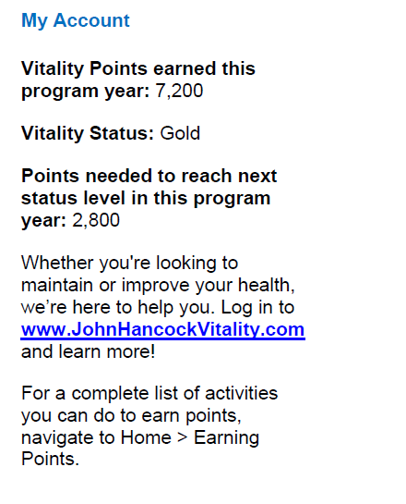
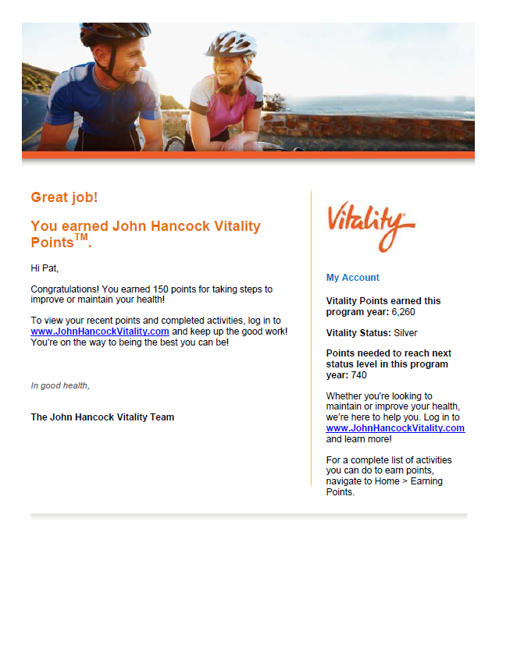
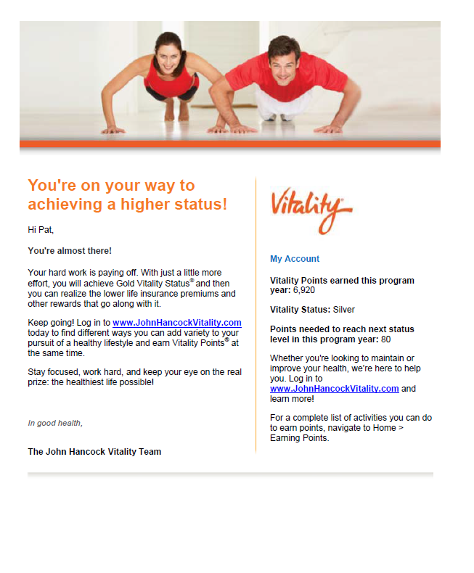
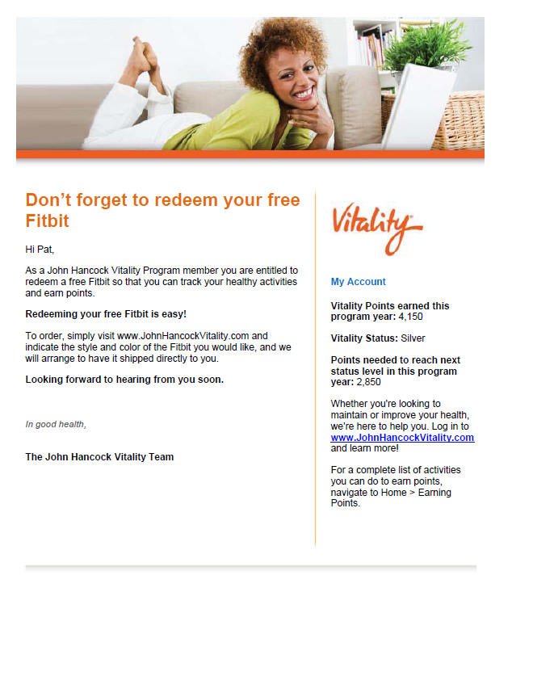
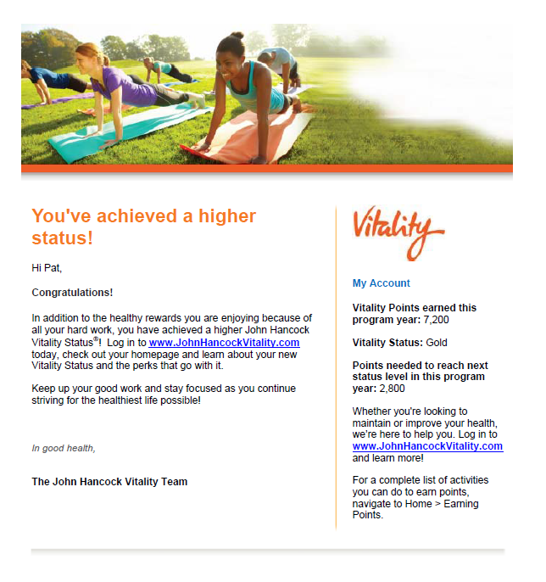
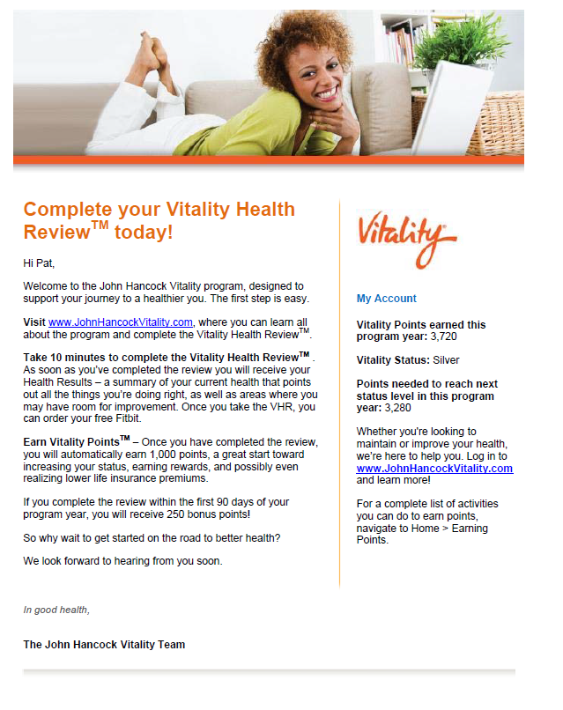
Regular Vitality Communication Emails
Complete Your VHR Today!
Don’t forget to redeem your Fitbit ®
Great Job! You earned Vitality Points!
You’re almost there!
You’ve achieved a higher status!

Slide 37
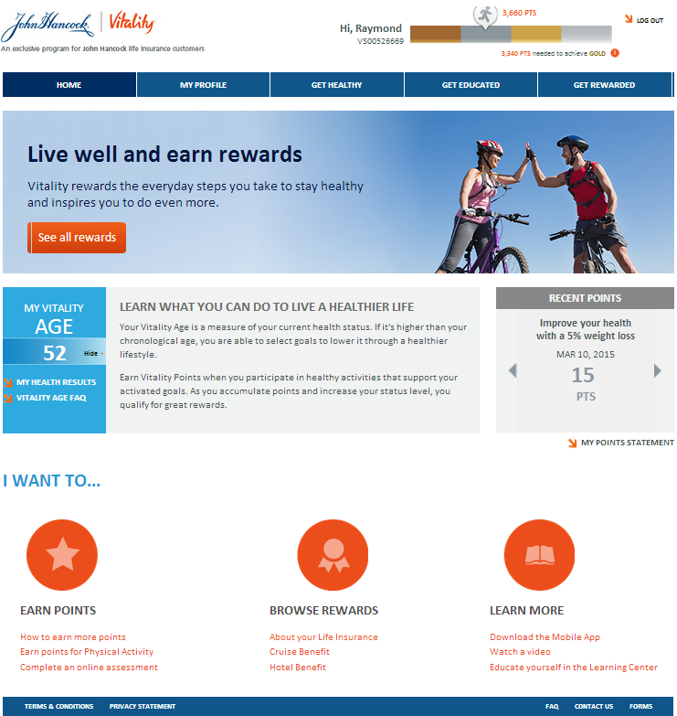
The John Hancock Vitality Website

Slide 38
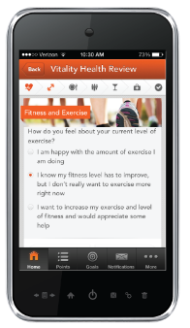
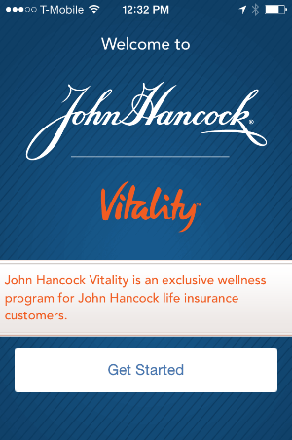
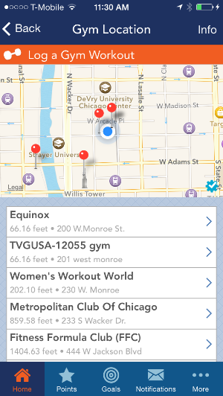
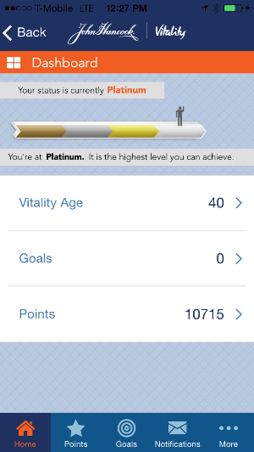
John Hancock Vitality App
Tracking Points is Easy

Slide 39

LifeTrack – What does it do?

Slide 40
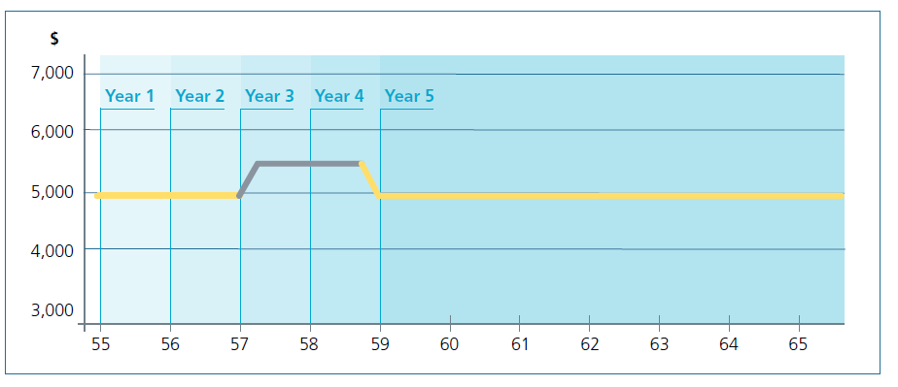
LifeTrack – What does it do?
A Dynamic Approach to Policy Management
LifeTrack automatically adjusts premiums!
Actual policy performance
Updated assumptions
Customized to meet your client’s unique goals

Slide 41
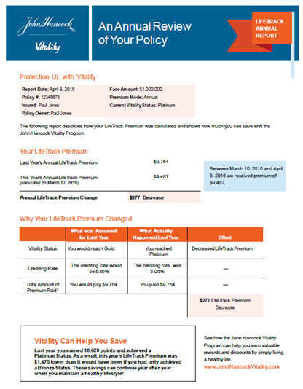
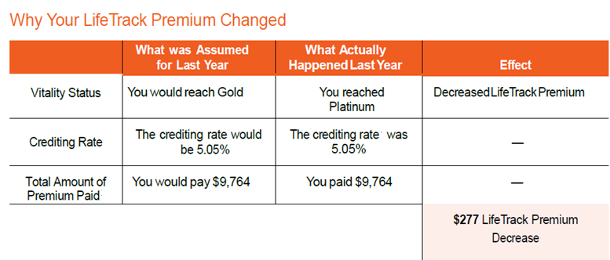
LifeTrack – What does it do?
Personalized Client Communications
Clear, concise premium explanation! It is like a built-in and automatic policy review!

Slide 42
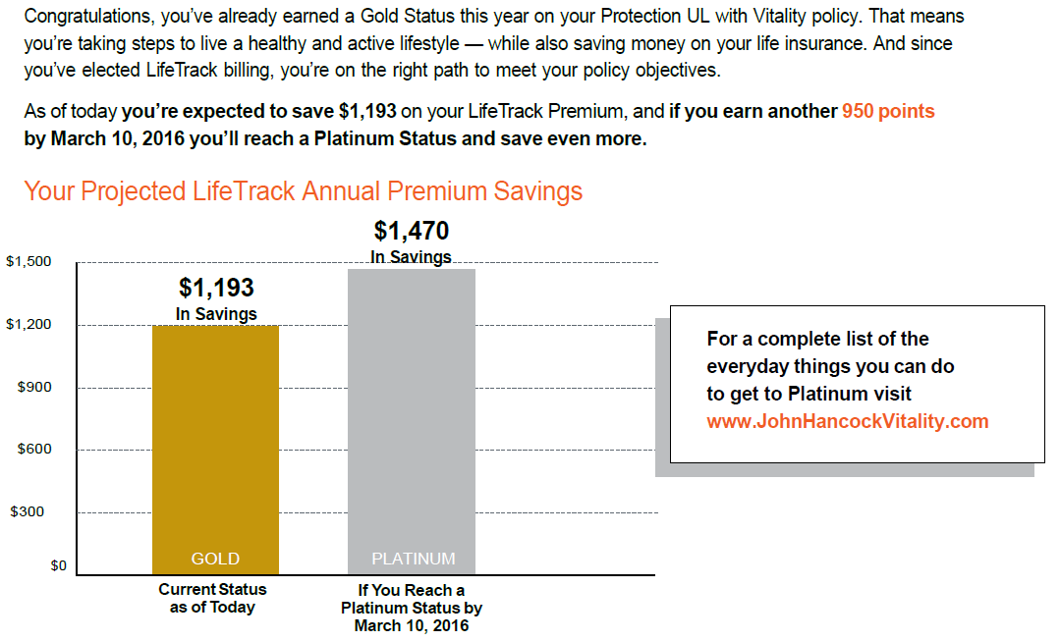
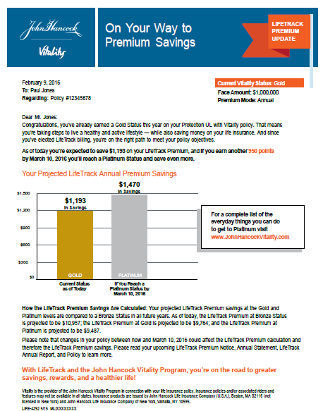
LifeTrack – What does it do?
Extra Motivation for John Hancock Vitality Customers
60 days prior to anniversary, your clients will receive a “Way to Go” email showing projected savings, based on their Vitality Status and encourages them to do even more!

Slide 43
Producer Communications
Reminder communications that are sent to clients who have not yet registered their policies
Quarterly producer reports summarizing clients’
  Status
  Points & points to next status level
  Activity status (reached a goal, no activity for 90 days…)
Reports will be downloadable from JHSalesNet website at a future date
Producers will receive copies of LifeTrack communications

Slide 44
Additional Resources
www.jhredefininglife.com
  Dedicated site focused on all things John Hancock Vitality
  Marketing materials, products, points, etc
  Client experience video
www.jhrewardslife.com
  Consumer website focused on John Hancock Vitality
  Actively promoted on our Launch Day in NYC, #5MoreNow, Social Media, Press, and via Finance and Wellness Bloggers

Slide 45
Questions?

Slide 46
Disclosures
For Agent Use Only. This material may not be used with the public.
Vitality is the provider of the John Hancock Vitality Program in connection with policies issued by John Hancock.
Insurance policies and/or associated riders and features may not be available in all states.
Premium Savings and Enhanced Income Potential will apply based on the Status attained by the life insured.
John Hancock Vitality Program rewards and discounts are only available to the person insured under the eligible life insurance policy. Rewards may vary based on the type of insurance policy purchased for the insured (Vitality Program Member), the ownership and inforce status of the insurance policy, and the state where the insurance policy was issued.
Paying a LifeTrack premium that is other than the planned premium on the initial ‘as sold’ illustration could reduce the duration of a policy’s Death Benefit Protection feature or No Lapse Guarantee.
REI is not affiliated with the John Hancock Vitality Program. REI does not sponsor, endorse or have any responsibility for this promotion. John Hancock Vitality Program rewards and discounts are only available to the person insured under the eligible life insurance policy. Rewards may vary based on the type of insurance policy purchased for the insured (Vitality Program Member), the ownership and inforce status of the insurance policy, and the state where the insurance policy was issued.
For John Hancock Term with Vitality policies, the level of rewards and discounts available will vary based upon the face amount selected at issue.
Insurance products are issued by John Hancock Life Insurance Company (U.S.A.), Boston, MA 02117 (not licensed in New York) and John Hancock Life Insurance Company of New York, Valhalla, NY 10595.

